Slide 1
Genesee County Agriculture & Farmland Protection Plan
Public Meeting
April 4, 2017

Slide 2
Agriculture & Farmland Protection Plans
Grants from NYS Department of Ag & Markets
County Plan builds upon 2001 Plan
Products: three separate documents
Genesee County Plan
Town of Alabama Plan
Town of Oakfield Plan

Slide 3
Project Overview
Conditions for Agriculture in Genesee County
The Agricultural Economy in Genesee County
Recommendations
Implementation Projects

Slide 4
Assessment of Agriculture in Genesee County

Slide 5
Excellent Conditions for Farming

Slide 6
Excellent Soils
88% of soils are important farm soils

Slide 7
High Participation in Ag District Program
64% of land is in Ag Districts
Another 5% is parks or State Refuge

Slide 8
Low Development Pressures
Most land in rural use
Crops: 57%
Wetlands: 18%
Wooded: 16%

Slide 9
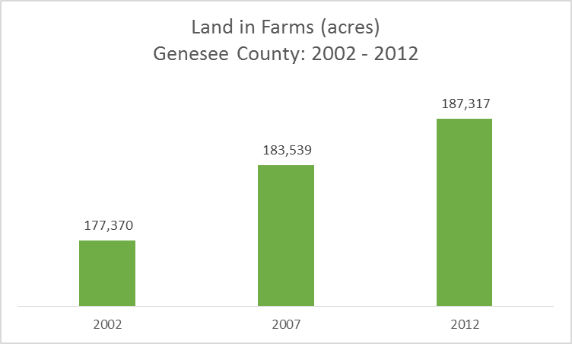
Land in Farms is Increasing
9,947 acres added to farm use between 2002 and 2017

Slide 10
Farm Sales Growing
65% growth 2002 to 2012

Slide 11
Average Net Farm Income Growing

Slide 12
Individual Farm Income Varies
26% of farms: high value
34% of farms: minimal sales

Slide 13
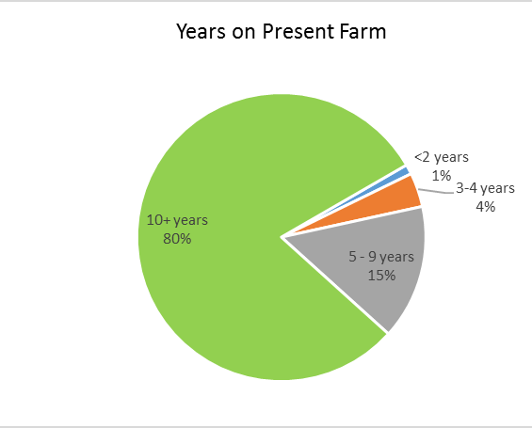
Experienced Farmers
Over 80% at least 10 years of experience
Only 5% less than 5 years of experience
Average tenure: 26.3 years
Farmers aging: average age was 58.5 years in 2012
35% over 65 years old
Nearly half over 60 years old

Slide 14
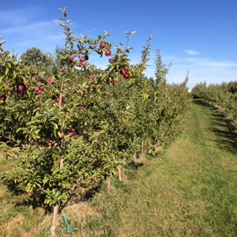
Strong Farm Ownership
61% of farms are owner occupied
Only 3% of farms are tenant farms
Majority of farms include a mix of owned and leased acreage

Slide 15
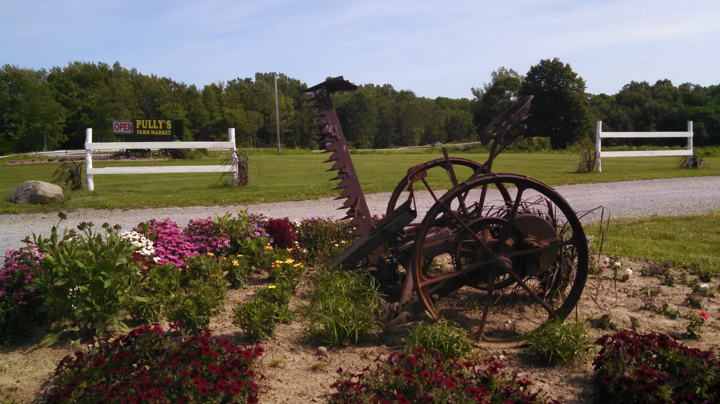
Supportive Communities
Virtually all Towns in the County explicitly support agriculture in Town Comprehensive Plan and in zoning
Survey of Towns reaffirmed this support
Strong County support for agriculture
Smart Growth Plan
Ag & Farmland Protection Plan

Slide 16
Assessment of the County’s Agricultural Economy

Slide 17
Genesee County: a Top Ag producer in NYS
Top NYS Farming Counties – by Sales
Rank | County | Value of Farm Sales | % of NYS
1 | Wyoming | $ 318,412,000 | 5.8%
2 | Cayuga | $ 289,235,000 | 5.3%
3 | Suffolk | $ 239,818,000 | 4.4%
4 | Genesee | $ 234,292,000 | 4.3%
5 | St. Lawrence | $ 186,431,000 | 3.4%
 | Top 5 Counties | $ 1,268,188,000 | 23.2%
 | New York State | $ 5,471,639,000 | 100.0%

Slide 18
Among State Leaders in Agricultural Sales

Slide 19
Benefit: Diversity of agricultural products

Slide 20
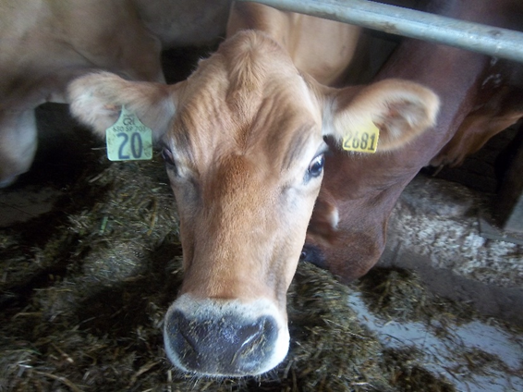
Dairy
County is 4th in State for dairy
29,000 mature dairy cows
1,100 beef animals
33,000 calves and heifers
Plus, a large proportion of County’s land supports dairy (silage, hay)
Milk remains largest source of agricultural revenue:
$237 million in 2012

Slide 21
Benefit: Strong Agricultural Markets
Genesee County benefits from strong markets for its agricultural products
Milk – yogurt, cheese, pet products, protein shakes
Vegetables – fresh & frozen
Grain/ Feed – feed (silage, corn meal), ethanol
Soybeans – fast growth, but issues with processing
Wheat – Canada
Local consumers (U-pick, farm markets, etc.)

Slide 22
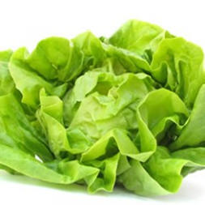
Benefit: Nearby Processors
Yogurt
Pet food
Cheeses
Vegetable Processing

Slide 23
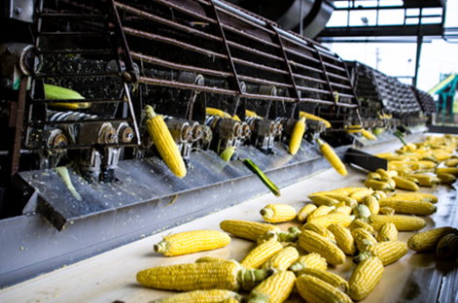
Opportunities
Former Mueller Greek yogurt plant – purchased by DFA
Demand for local products
Fresh Produce (e.g. bagged greens)
Specialty items (mushrooms)
Greenhouse production
Centralized processing (e.g. Pride-Pak)
Alleviates need for on-farm processing, packing

Slide 24
Concerns
Canadian Competition – exchange rate
Regulations (immigration policy, Clean Water Act, labor regulations)
Labor & wages
Property Taxes
Potential development pressures
Price volatility
Infrastructure (broadband, roadways, water)

Slide 25
Recommendations

Slide 26
Public Outreach
Steering Committee Meetings
Meetings with farmers
Meetings with agencies
Meetings with land conservancies
Meetings with support services (suppliers, producers)
Municipal survey
Informal outreach – events/ interviews

Slide 27
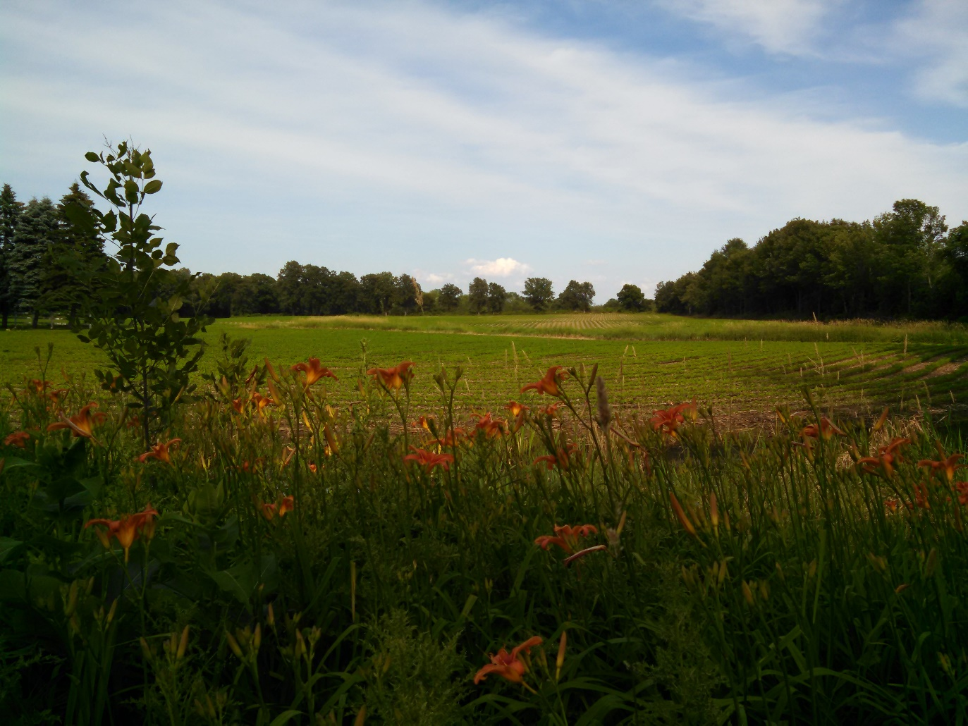
Goals
Retain Prime Farmlands for Agricultural Use
Recognize the Value of Farming as an Economic Activity
Provide Infrastructure Needed for a Successful Agricultural Economy
Educate and Engage the Consumer

Slide 28
Recommendations: Land
Support the County’s Smart Growth Plan
Develop sample zoning and subdivision codes for Towns
Creative Approaches to Purchase of Development Rights
Farmland Protection Implementation Grants
Explicitly consider agriculture in County decision-making

Slide 29
Recommendations: Economic
Explore new markets for traditional products
(milk, corn, leafy vegetables, other value-added products)
Identify niche markets
(organic produce, hops, meat-processing)
Targeted Incentives in support of agriculture
(access to capital, succession planning, technical assistance)
Skills development
(Middle management skills, Ag technology, etc.)

Slide 30
Recommendations: Infrastructure
Water District Language
Drainage/ Stormwater management
Roads/ Traffic
Broadband
Natural Gas
Electricity
Institutions (e.g. Cornell Cooperative Extension, BOCES, SWCB, etc.)

Slide 31
Recommendations: Educate & Engage
Educational materials for new residents
(what to expect in an agricultural community)
Event Outreach
(decision-makers tours, etc.)
Programming in schools
(FFA, Ag tech, elementary school outreach about where food is from)
Advocacy
Encourage representation of agricultural issues at Town level (TB, PB, etc.)
Farm Products Fact Sheet – importance of agriculture to local economy

Slide 32
Implementation Projects

Slide 33
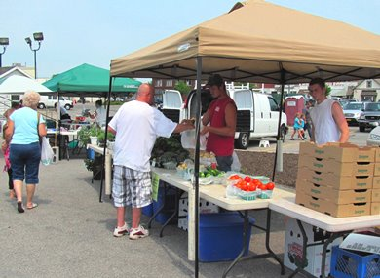
Downtown Batavia Healthy Living Hub
Collaboration between downtown Batavia Farmers’ Market, the Fresh Lab and other partners
Incubator for farm-to-table restaurants
Coordinated with local wellness programs
Events

Slide 34
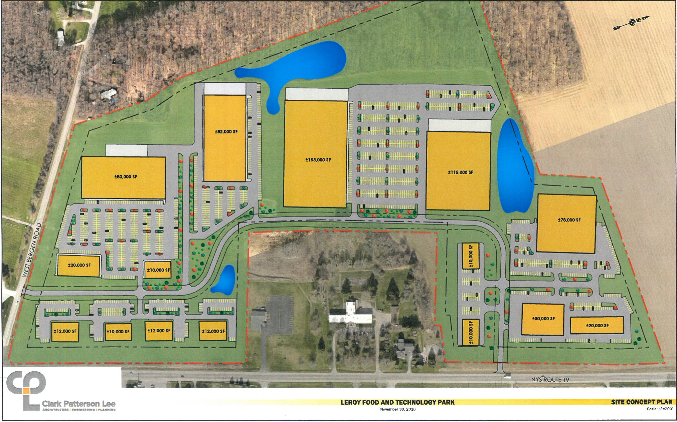
Redevelopment of LeRoy Food & Tech Park
Potential food processing facilities

Slide 35
Community Digester
Food waste to energy generation

Slide 36
21st Century Infrastructure
Broadband
Water
Electricity
Natural Gas
Improved roadways

Slide 37
Next Steps
Finalize the Plan
Review by Agriculture and Farmland Protection Board
SEQR
Adoption by Genesee County
IMPLEMENTATION!

Slide 38
Questions & Comments

